Slide 1
Software Project Management Plan
第12组PPT
Group members:
王文静 283
潘佳琪 280
陈明辉 243

Slide 2
Contents
行业PPT模板http://www.1ppt.com/hangye/
01
03
Introduction
Technical Process
02
04
Management Process
Development Schedule

Slide 3
01
Introduction

Slide 4
1.1 Overview
An overview of the cinema ticketing system:
This project is to develop a simple cinema ticketing system. With the continuous improvement of people's living standards, people's lifestyle is no longer limited to the improvement of ordinary materials such as clothing, food, shelter and transportation, but also pursues a qualitative mutation in spirit. In response to this demand of the public, many movie ticketing applets have been born. The management and service mechanism of the cinema market requires intelligence step by step. For the cinema management department, booking is the most basic business of all businesses. On the surface, it is only a simple part of the cinema business, but it involves many aspects such as management and customer service, and online ticket purchase provides users with a convenient and fast way to purchase tickets.

Slide 5
1.2 Project delivery products
02
Source program check
01
Submit documents
Check the operation of each module, check the operation of the entire system, and submit the program source file and executable system after the check is completed. Program checks are scheduled to take place during start-up time.
project management plan, plan report PPT, test report

Slide 6
1.3 Project organization
Members | Roles | Responsibilities
Wang Wenjing | Front-end development engineer, Test engineer | Mainly responsible for product page and user experience design, product testing.
Pan Jiaqi | Product manager, Back-end development engineer | Responsible for researching market demand, ensuring product functions and features, responsible for back-end development and database management.
Chen Minghui | Project Manager, Operation and maintenance Engineer | Responsible for the planning, organization, implementation and control of the project, as well as the deployment and maintenance of the product.

Slide 7
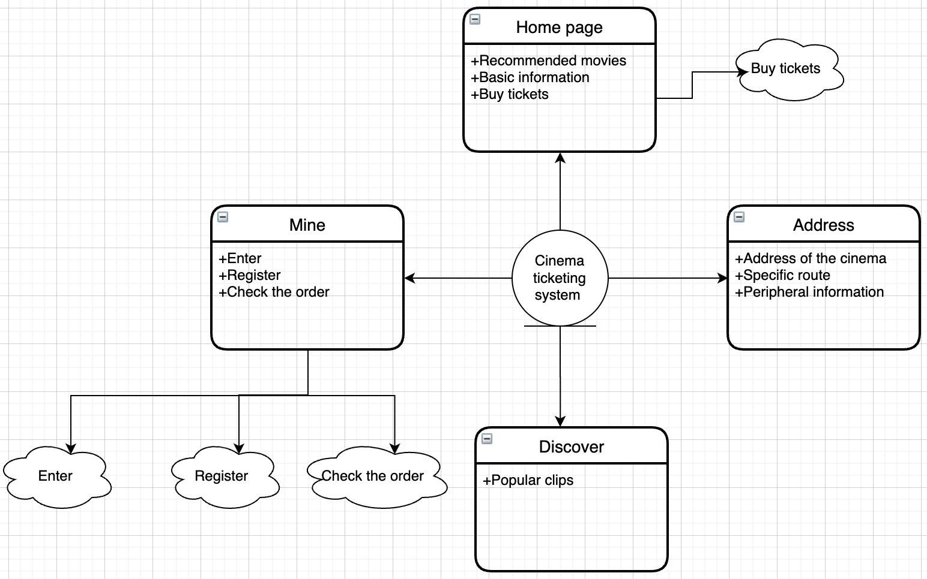
1.4 Functional modules of the system

Slide 8
02
Management Process

Slide 9
2.1 Management goals and priorities
Complete the basic functions of the project on time and in quantity, and release products and documents on time
Goal 1:
Basic management principle:
Follow the standardized project operation standards, rigorous and complete documentation, sufficient code comments, and facilitate subsequent maintenance
Goal 2:
Each team member is both an active advisor, a responsible collaborator, and a decision-maker.
Decisions should be made jointly by all on the basis of full discussion and must be implemented in a timely and effective manner once they are made. No further objections are prohibited.
Goal 3:
The product runs stably, the interface is friendly, the user is easy to operate.
Goal 4:
Weekly seminars are positive.Actively collaborate during development.

Slide 10
2.2 Risk management
Skilled development technology is not enough
Lack of adequate art support
we decided to make a one-week study plan in advance, and systematically learn about the development tools and development environment.
Due to the lack of art technology, the interface is not friendly, so we will study UI design in depth and actively seek foreign help.
The course is tight and the construction period is postponed
If an extension is necessary, the group leader should explain it to the teacher in time and apply for an extension.

Slide 11
2.3 Personnel plan
1.Project Manager
4.Operations Engineer
2.Product Manager
5.Test Engineer
3. Front-end development Engineer
6. Back-end development Engineer

Slide 12
2.3 Personnel plan
Product Manager:Pan Jiaqi
Responsible for investigating market demand, determining product functions and features, writing requirements documents and product plans, supervising the progress in the product development process, and ensuring that product development meets market demand and user needs.
Project Manager：Chen Minghui
Responsible for the planning, organization, implementation and control of the project, coordinate the work among the project team members, manage the progress and quality of the project, and ensure that the project is completed on time and according to quality.
02
01
03
06
04
05

Slide 13
2.3 Personnel plan
Operations Engineer：Chen Minghui
Front-end development engineer：Wang Wenjing
Responsible for product deployment, maintenance, monitoring and optimization to ensure stable operation and high availability of products.
Responsible for the design of product interface and user experience, familiar with Node.js module design, including visual design and interaction design, etc., to ensure that the product interface and user experience meet user needs and design standards.
02
01
03
06
04
05

Slide 14
2.3 Personnel plan
Back-end development engineer：Pan Jiaqi
Test Engineer：Wang Wenjing
According to product requirements and design, responsible for software or hardware development, testing, deployment and maintenance, including back-end development, database management and other work.
02
Responsible for testing products, finding and reporting defects and problems in products, ensuring the quality and reliability of products.
01
03
06
04
05

Slide 15
2.4 Study Plan
Node.js module
Asynchronous programming
HTTP services and routing
Learn how to use the Node.js module system, including how to import and export modules, and how to create own modules.
To adopt the asynchronous programming model, it is necessary to master asynchronous programming technologies such as callback functions, event-driven programming, Promises, and async/await.
Learn how to create HTTP servers and routes using Node.js, and how to handle HTTP requests and responses.

Slide 16
2.4 Study Plan
Databases
WXML+WXSS
Learn how to use Node.js connect and learn SQL statements and how to manipulate databases such as MySQL.
Learn WXML templates, WXSS styles and JS logical interactions, such as tags, elements and attributes. Learn JS basic grammar, applet framework and basic components.

Slide 17
03
Technical Process

Slide 18
3.1 Develop tools, methods and techniques
Programming Language：JavaScript；
Database：MySQL；
Database management：SQLyog；
Team organizational structure: main programmer organizational structure;
Adopt unified JavaScript standard file naming methods, code layout, comments and other coding specifications;
Design methodology：object-oriented；
Integrated development environment: WeChat developer tools;

Slide 19
04
Development Schedule

Slide 20
Development schedule
Preparation phase
Date：2023.03.10-2023.03.30
formulating the plan and task book, knowledge reserve, setting up the development environment, and collecting and processing data.
Assessment phase
Date：2023.04.21-2023.05.11
This stage is the risk assessment, software testing and modification phase to ensure that the project can be perfectly realized.
01
02
03
04
05
06
Development phase
Date：2023.03.31-2023.04.20
This stage is the most important stage, creating training and test data, building mini programs, predicting reactions, front-end and back-end design, code debugging, and finally being able to submit a demo.

Slide 21
Development schedule
Optimization phase
Date：2023.05.12-2023.06.01
Optimize projects, optimize artwork, and improve user experience.
01
02
03
04
05
06
Acceptance phase
Date：2023.06.01-2023.06.07
The software is delivered, and the whole system can run successfully and stably.

Slide 22
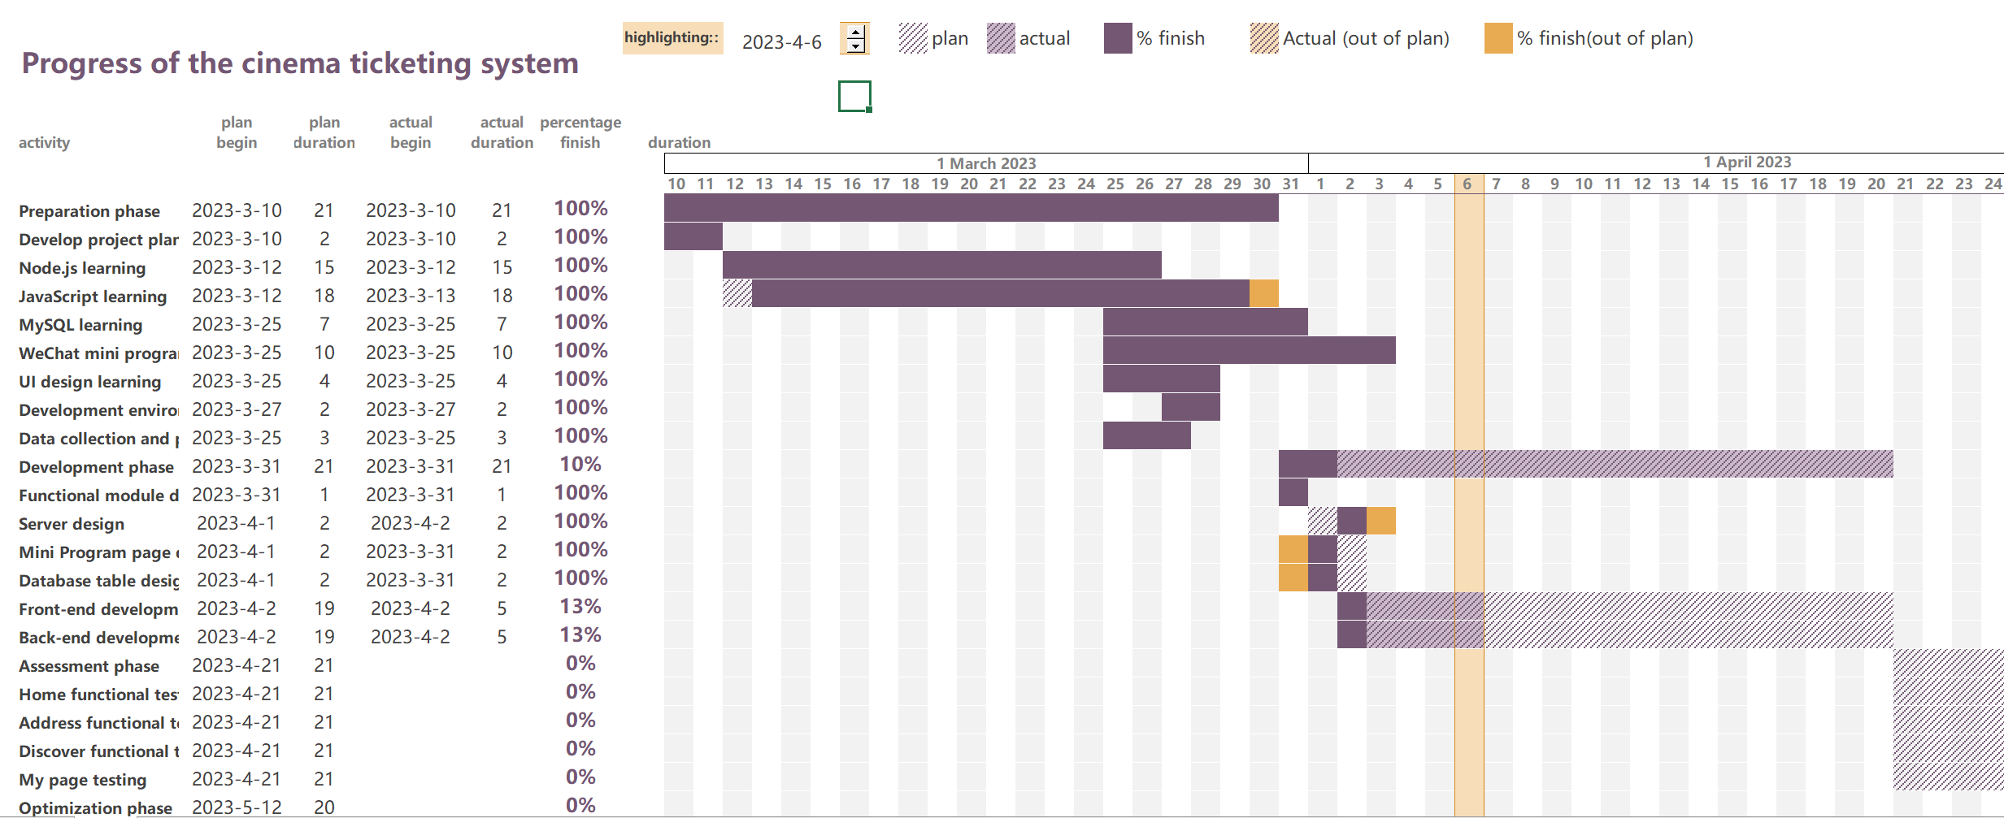
Partial project plan execution

Slide 23
Thanks for watching
第12组PPT

